Slide 2
3M ESPE Conflict of Interest Disclosure
“As an employee of 3M ESPE,
I have a financial interest in 3M ESPE
Dental medications, materials or
equipment discussed during this program”
Notes:
2
Before we get started let me review the obligatory disclaimer that the AGD asks us to disclose prior to any seminar.
REPS this is a mandatory slide to include in the presentation

Slide 3

Power of Prevention
Andrea Wiseman, RDH
3M ESPE Preventive Care

Slide 4
Power of Prevention
Preventive Care
Andrea Wiseman, RDH
3M ESPE Preventive Care

Slide 5

Texas Blue Bonnets

Slide 6
Goals:
Understanding CAMBRA
Identify via risk assessment for Caries:
  Low Risk, Moderate Risk, High Risk
  Risk Assessment Chart
Review Medication that are dispense from office:
  Understanding Parts per Million (ppm)
  Hydroxapatite - Fluoroapatite
  Varnish, Sodium, Stannous, CHX
  Calcium Phosphate technologies
Protocols, Dialog, and Insurance Codes
  How to implement medications into a caries risk management
  program
  Best Chance for Success
  Educate
  Motivate
  Medicate
© 3M 2008. All Rights Reserved.
Notes:
6

Slide 7

Oral Health Care Providers are responsible for identifying Risk Factors inside the oral cavity before disease occurs.
CaMBRA
Caries Management by Risk Assessment
Identifying Risk Prior to Cavitations

Slide 8
CAMBRA
Caries Management by Risk Assessment
Notes:
Today we will cover the following topics.

Slide 9
Risk Factors That May Increase Caries Risk
Including, but not limited to (Source: ADA www.ada.org):
Fair to Poor oral hygiene
Poor family dental health
Irregular dental care
Many multi-surface restorations
Chemotherapy, radiation therapy
Drug or alcohol abuse
High titers of cariogenic bacteria
Cariogenic diet
Active orthodontic treatment
Developmental or acquired enamel defects
Presence of exposed root surfaces
Restorations overhangs, open margins
Physical or mental disability with inability to perform proper oral health care
Genetic abnormality of teeth
Xerostomia
© 3M 2008. All Rights Reserved.
Notes:
9
So this is the risk assessment slide I have been referring to.
Let’s look at what is on this list:
Daily how many of your patients have at least 2 of these risk factors? Do you see where I am going with this asking you about the number of your patients that you see each day that fall into one of these categories?
Remarkably, when we ask these same questions to the RDH’s in the practices we work with. We hear answers of any where from 50% to 90% of all patients assessing to be moderate to high risk. So there is no question, we have a lot of need out there for prevention of future decay. It is up to us to educate, motivate and medicate our patients in order to most effectively help them.

Slide 10
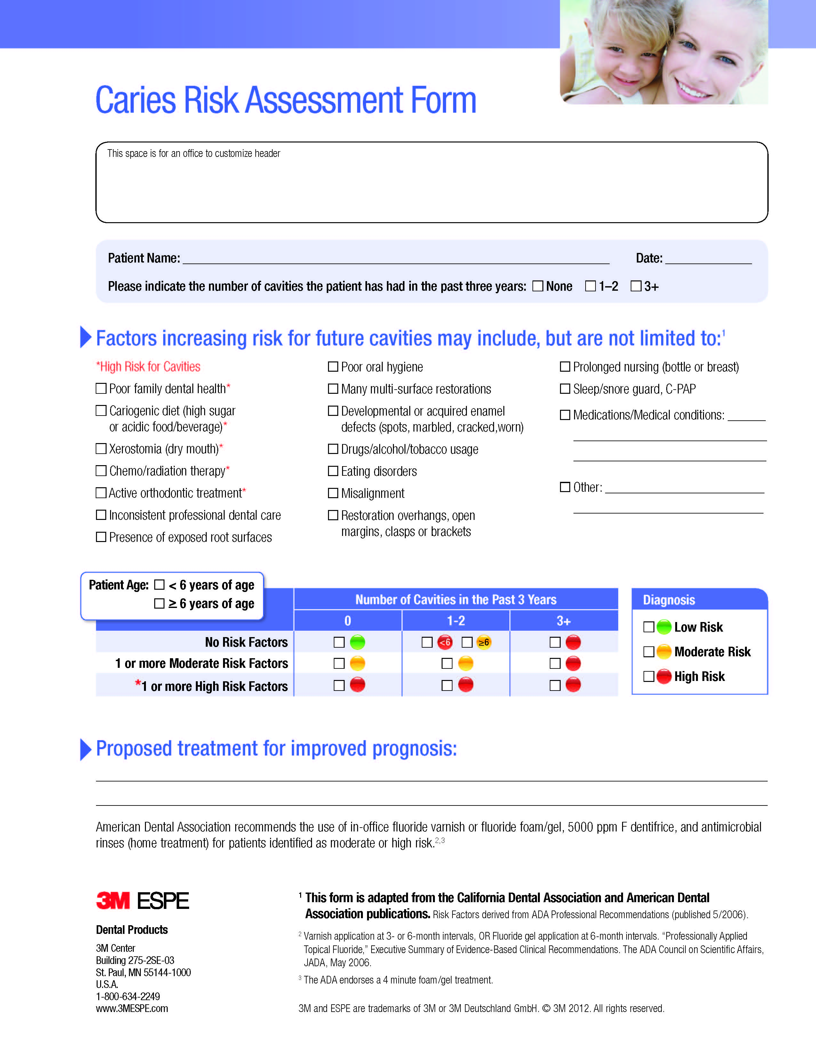
© 3M 2008. All Rights Reserved.

Slide 11
Moderate Risk
6 + Years Old
In office fluoride varnish with calcium and phosphate
Therapeutic Xylitol chewing gum or mints (2 grams 3 x’s daily
Avoid alcohol based mouth rinses
Low abrasive OTC or Medicated fluoride toothpaste
Re-Evaluate in 3 to 4 months
Immediate benefits:
Control
Caries risk reduction
Enhance profit (average fee $25 )
© 3M 2008. All Rights Reserved.
Notes:
Arm and Hammer Age Defying with calcium and phosphate. Control peace of mind caries risk reduction 74% vs 37 Safe and effective
11

Slide 12
High Risk Protocols
6 + years old
In office fluoride varnish with calcium and phosphate
Therapeutic Xylitol chewing gum or mints (High risk 2 grams 5 x’s daily
Avoid alcohol based mouth rinses
Medicated prescription strength toothpaste with calcium phosphate
Home Care Review
Re-Evaluate in 3 months
Immediate Benefits:
Caries risk reduction, arresting and reversing early caries.
Increases patient and staff compliance
No trips to the store
Decreases product interactions
Enhanced production (Average fee $45 for both)
© 3M 2008. All Rights Reserved.
Notes:
The only thing leaving the practice is c5k. If you do nothing else dispense c5k it will reverse early caries
12

Slide 13
5 days a week/ 48 weeks a year
Production increases decay decreases
Production Before CaMBRA
$240,000
Production After CaMBRA
$340,560

Slide 14
5 days a week/ 48 weeks a year
Production increases decay decreases
Before Implementing CaMBRA
8 Hygiene Patients / day@$125 each = $1000 / day
=$5000 / week
=$240,000 / year
After Implementing CaMBRA
8 Hygiene Patients / day
  1 - Low to Moderate Risk
  6 – High Risk
  1 – Extremely High Risk
Total Production = $1419 / day
=$7095 / week
=$340,560 / year

Slide 15
De-Mineralization
And
Re-Mineralization
Dental caries result when the rate of demineralization exceeds the rate of remineralization and the lattice work is destroyed.
Fluoride, Calcium and Phosphate aid in strengthening the weak lattice work to prevent cavitations.

Slide 16
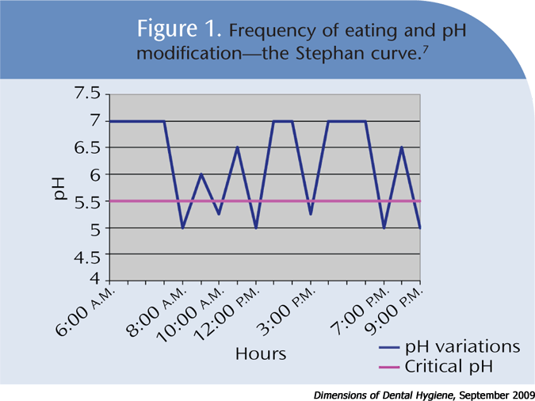
PH Balance in the Oral Cavity of an Average Patient

Slide 17
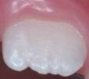
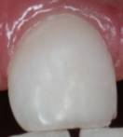
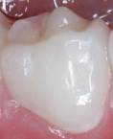
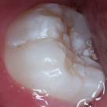
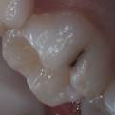
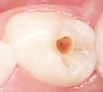
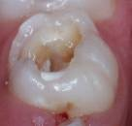
Dental Caries – Progressive Disease
No Caries
White Spot Lesion
Frank Cavitated Lesion
At what stage does de-mineralization start, and when do you first see it?
Notes:
Visually, this process progresses as follows. Healthy tooth, white spot lesions, brown spot lesions, cavitated lesions, pulpal lesions and finally extraction. Interventions exist at every stage and are defined very well by ICDAS, the international caries detection and assessment system. These guidelines and information on recommendations are available at www.icdas.org.

Slide 18
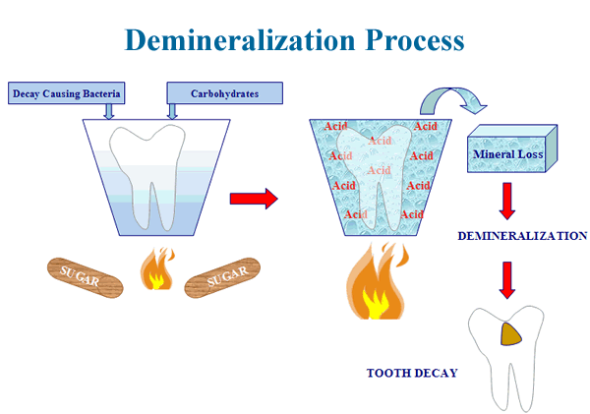

Slide 19
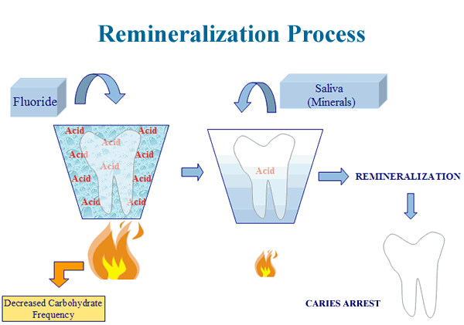

Slide 20
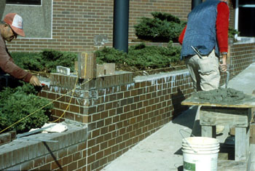
Remineralization Ca +PO4 = Hydroxapatite
Ca + PO4 + Fl- = Fluoroapatite
Hydroxyapatite
  Calcium & Phosphate
    Supplied by saliva
  Natural Tooth Structure
Fluoroapatite
  Hydroxyapatite in the presence of fluoride
  More resistant to acids
  Not required, but enhances remineralization
Notes:
Remineralization is the process of adding minerals back to the tooth after acids demineralize the natural tooth structure. The teeth are made of calcium and phosphate crystals called hydroxyapatite. These minerals are the hardest substance the human body produces. When acids contact these crystals for extended periods of time, they demineralize or dissolve away slowly. Sound/healthy teeth do not readily absorb fluoride so some microscopic demineralization is present when fluoride is added. Remineralization can occur with calcium and phosphate found in the saliva or from additional calcium phosphate sources such as Clinpro 5000, or other products. It can also occur with fluoride containing products. The addition of fluoride to this process will create a mineral called fluorapatite which is more resistant to demineralization than standard hydroxyapatite. This mineral to the naked eye is identical to hydroxyapatite, but provides greater protection to the patient in the future from acid dissolution. Adding fluoride will create an immediate hard layer on the top of a white spot lesion which gradually migrates to the remainder of the lesion remineralizing the entire white spot. This protective outer layer helps cover weakend white spots while the body of the lesion remineralizes and provides a reservoir of calcium fluoride to aid in remineralization. Think of teeth as you would a brick wall. Calcium and phosphate being the bricks (the main body of the tooth), fluoride the cement. You can build a brick wall with just bricks, but if you add mortar between the bricks the wall becomes much more sturdy. We want to build fluoroapatite, brick walls with mortar.

Slide 21

“45-year old male, good oral hygiene. No carious lesions, no lesions restored in the last three years. Diabetic, uses salivary reducing medications, last dental visit 2 years ago with radiographs”.
Low, Moderate, or High Risk???

Slide 22
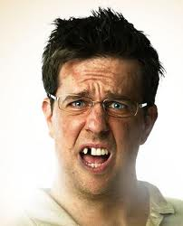
26-year old male, history of restorations for carious lesions 18 months ago, no missing teeth, carious lesions on teeth #4, #5, #18, and #31. Poor oral hygiene, decalcification numerous cervical areas.
Insurance driven.
Low, Moderate, or High Risk???

Slide 23
PREVENTION
MEDICATIONS
Understanding

Slide 24
Parts per million of Fluoride
Parts per million

Slide 25
Water Fluoridation Changes 2011
U.S. Department of Health and Human Services (HHS) and the U.S. Environmental Protection Agency (EPA) changed water fluoridation recommendations
  0.7 ppm F rather than range of 0.7 to 1.2 ppm F
  First change in ~50 years
  Change due to additional sources of Fluoride that were less prevalent in previous years
  Maximizes benefit and minimizes unwanted effects
Additional supporting information
  http://water.epa.gov/action/advisories/drinking/fluoride_index.cfm

Slide 26
Sodium Fluoride: small ion; has 2 label indication:
Caries Control – moderate to high risk caries patients
Sensitivity
It works by strengthening the teeth and decreasing the effects of acid and bacteria on the teeth.
*The American Dental Association recommends that at least 80% of the labeled amount of fluoride is released during tooth-brushing in the first 2 minutes. You must have water in the medication in order for the fluoride to be released to its ionic form.
© 3M 2008. All Rights Reserved.

Slide 27
Types of Products that have Sodium Fluoride
Toothpaste- OTC: 1100 ppm, Rx: 5000 ppm
  Neutral pH- Prescription
Foams & Gels- 12,300 ppm
  1.23 APF
  pH 3.0
Rinses
  2% Neutral pH – 2000 ppm
  1.1 Neutral pH – 5000 ppm
Varnishes – 22,600 ppm
  Neutral pH

Slide 28
RDA Table
  0 to 70
  Low abrasive
  70 to 100
  Medium abrasive
  100 to 150
  Highly abrasive
  150 to 250
  Regarded as harmful limit
  Issue Date: October 2009, Posted On: 11/1/2009 RDH Magazine
  Polishing Techniques for Beauty and Longevity
  Trish Jones RDH, BS

Slide 29
Sodium Fluoride & Sodium Monofluorophosphate
NaF
  Water soluble
    Patients must wait 30 minutes to eat/drink (except varnishes)
  Hard tissue only
    No or limited gingival benefit
  Non Bacteriocidal
MFP
  Water soluble
    Patients must wait 30 minutes to eat/drink
  Hard tissue only
    No or limited gingival benefit
  Not readily available
  Non Bacteriocidal
See Prescribing Information for complete information
Notes:
However, with all products there are some limitations. Sodium fluoride is water soluble unless another ingredient is designed to hold it on the tooth structure (varnishes). Patients do need to wait 30 minutes before washing away the ingredient. This should allow calcium fluoride formations to bind to the tooth and begin the remineralization process. Sodium fluoride is also not antimicrobial and has very little effect on the health of the gingiva. Other products are more suited for patients suffering from gingivitis. MFP also has the same properties, but it’s also more difficult to release the fluoride from MFP formation.

Slide 30
Prescription Level
Dentifrices or gels
1.1% Sodium Fluoride (5000 ppm F):
  First introduced in 1996 by Colgate
  Provide over 4 times the fluoride as OTC pastes and gels
  Excellent patient compliance due to ease of use
  Not to be used by patients < 6 years of age
  Indicated for caries prevention
  Used off label for treatment of hypersensitivity
© 3M 2008. All Rights Reserved.

Slide 31
1.1% Sodium Fluoride pastes or gels
Prescription Medication
Top Brands
  Clinpro™ 5000
  Prevident® 5000+
  Prevident® Booster
  Fluoridex™ 1.1% Neutral Sodium
© 3M 2008. All Rights Reserved.

Slide 32
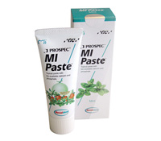
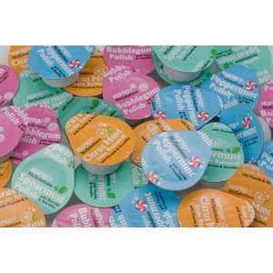
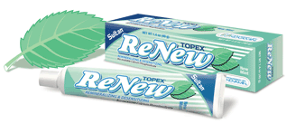
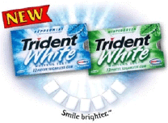
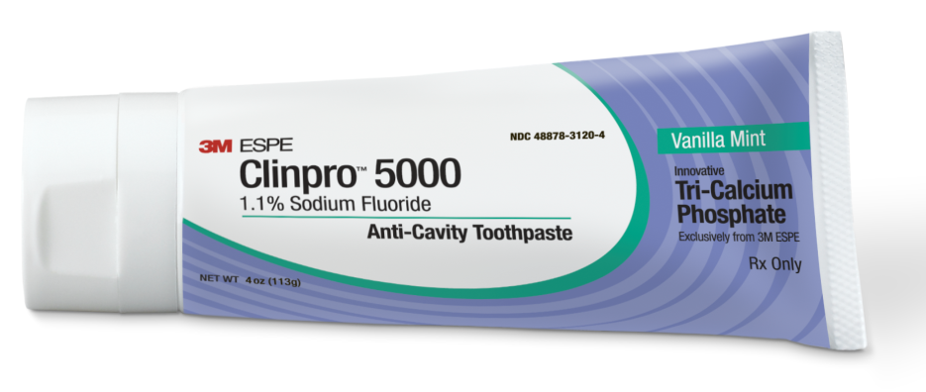
Calcium & Phosphate
Technology

Slide 33
ACP is inorganic amorphous calcium phosphate, made by combining soluble salts of calcium and phosphorous. When the two salts are mixed, they rapidly form amorphous calcium phosphate that can precipitate onto the tooth surface then dissolve into the saliva to be available for tooth Remineralization. Highly soluble. Not prescription strength.
Recaldent® - ACP-CPP
The milk derived peptide containing Ca and PO binds to natural plaque. Holds calcium and phosphate against the tooth surface. Is released during acid challenges. Rinses away easily due to acid challenges throughout the day. Not a prescription strength.
Novamin-A synthetic mineral composed of calcium, sodium, phosphorous and silica, all elements naturally occurring in the body. Along with Na+ that increases oral pH, creating the ideal conditions for rapid tooth remineralization. Prescription strength
Tri-Calcium-Phosphate- keeps the fluoride, calcium and phosphate separate until it comes into contact with saliva. The barrier breaks down and makes the fluoride, calcium and phosphate readily available to deposit on the tooth surface to create fluorapatite. Prescription strength toothpaste only.

Slide 34
Comparison
OTC
Sodium Fluoride only
Sodium Fluoride with Calcium Phosphate

Slide 35
OVER THE COUNTER TOOTH PASTE

Slide 36
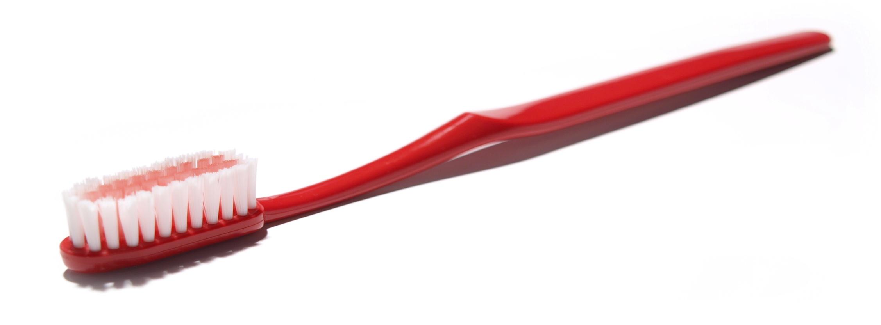
How Much Toothpaste do you put on a ToothBrush?

Slide 37
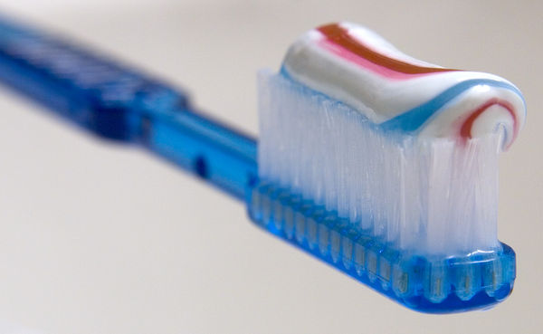
Aquafresh Curl

Slide 38
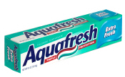

Active Ingredients:
Sodium Monofluorophosphate 0.15% or 500ppm
W-V of Fluoride Ion MFP

Slide 39

Sodium Fluoride
900ppm
900 ppm Fluoride OTC
Less effective formula
1.4 oz tube – 2-3 months of product
$13.00 per tube ($9.29 per oz)
Second hygiene step
Not sold OTC
G
Notes:
If you happen to be using MI Paste Plus, or looking into using it, here is how CP5 stacks up:

Slide 40
PRESCRIPTIVE STRENGTH
1.1% SODIUM FLUORIDE

Slide 41
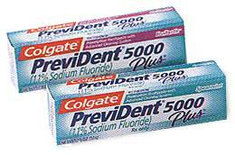
1.1 % Sodium Fluoride (5000ppm)
1.8 oz tube – 3 months of product
$3.77 per oz
More abrasive (90-RDA)
1.1% Sodium Fluoride Only
No Calcium
S
Notes:
Here is how we stack up against our competitor’s other 5000 ppm brand:

Slide 42

1.1% Sodium Fluoride (5000ppm)
Liquid formula
3.58 oz package
More abrasive
1.1% Sodium Fluoride
RDA Score 90
Cost: $7.00 average
Not sold at Pharmaceys
No Calcium
S
Notes:
So just in case you are using this competitor product…here is a summation of how CP5 stacks up:

Slide 43
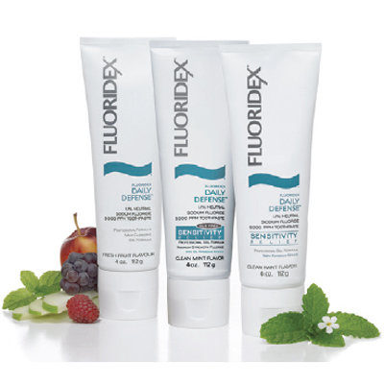
1.1 % Sodium Fluoride (5000ppm)
Fluoridex™
1.1% Neutral Sodium Fluoride
5000 ppm
Mint Flavor
4oz tube
Cost : $6.50
No Calcium Phosphate
90 RDA score
Instructions: PLACE AT LEAST a 1 inch strip onto a soft bristle toothbrush and brush for 1 minute.

Slide 44
Prescriptive Strength
1.1 % Sodium Fluoride
With
Calcium and Phosphate

Slide 45
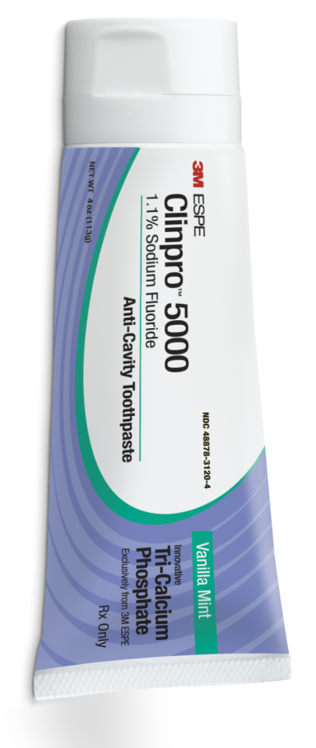
Clinpro™ 5000
1.1% Sodium Fluoride Anti-Cavity Toothpaste with Tri-Calcium Phosphate
  5000 ppm Sodium Fluoride
  Innovative formula containing Tri-Calcium Phosphate technology (TCP)
    2 proven technologies in 1 product (5000 ppm F & Calcium Phosphate)
  Remineralizes more effectively than leading brands
  RDA score of 60-gentle on root surfaces
  Vanilla Mint flavor
  4 oz package (6 month supply)
  One step patient use
  Introduced to market January 2009
© 3M 2008. All Rights Reserved.

Slide 46
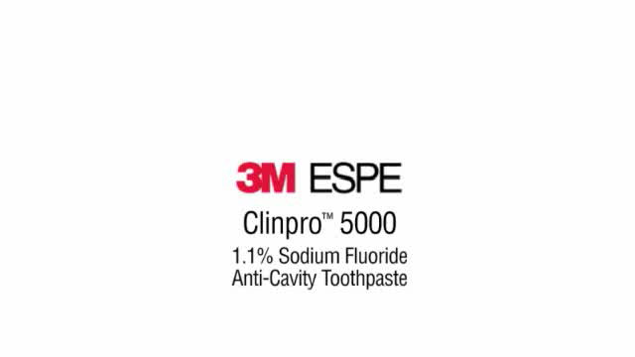

Slide 47
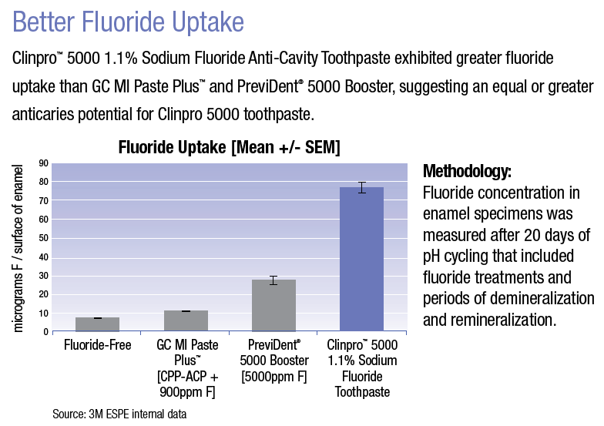

Slide 49
Clinpro™ 5000
Prescription strength
FDA approved claims for prevention of caries
Once per day, substitutes for conventional toothpaste
Fluoride uptake over 7x than any other medicated toothpaste
Vickers microhardness increase over 10x harder than any other medicated toothpaste
4 oz tube
Cost $11.87 per tube
3 Flavors: Vanilla Mint, Spearmint, Bubble Gum

Slide 50
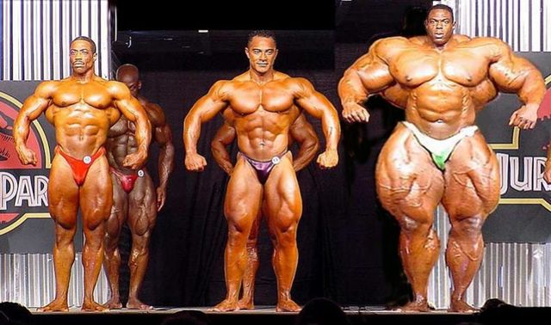
ACP
Sodium Fluoride
Tri-Calcium

Slide 51
FLUORIDE VARNISHES
  Approved in US in 1994 (Europe 1960’s)
  US FDA label indication- Cavity liner and hypersensitivity
  Used off label as fluoride treatment
  Long lasting resin (24 to 48 hours)
  Safe for all pediatric patients
  5% Sodium Fluoride, 22,600 ppm F
  White (invisible) or yellow color on teeth
  Less F ingestion compared to tray delivered gels and foams
  Easy to apply
  No waiting to eat or drink
© 3M 2008. All Rights Reserved.

Slide 52
“Fluoride Varnishes: A Review of Their Clinical Use, Cariostatic Mechanism, Efficacy and Safety”, Beltran-Aguilar, E., et al, Journal of the American Dental Association, Vol. 131, May 2000: pp.589-596.
“…after 2.5 years, the varnish resulted in a higher percentage of caries reduction (74 percent) than did the NaF solution (28 percent) and the APF gel (37 percent).”
© 3M 2008. All Rights Reserved.

Slide 53
CHARACTERISTICS of Varnishes
22,600 ppm NaFl-
Label Indication: Hypersensitivity
Color
Flowable
Do you have to dry the teeth?
Can they eat and drink ?
Is it Tenacious?
Cost
Flavors
Post op directions
Is the Dr. able to apply it?

Slide 54
States with MEDICAID Funding for
Physician Oral Health Screening and Fluoride Varnish
VT
AK
WA
MT
ME
ND
NH
MN
MA
OR
ID
WI
NY
RI
WY
SD
MI
PA
CT
NE
IA
IN
OH
NJ
NV
IL
DE
UT
CO
WV
VA
CA
KS
MO
KY
MD
NC
HI
OK
TN
AZ
NM
AR
SC
MS
AL
GA
TX
LA
DE
RI
FL
DC
Medicaid coverage approved
NJ
Approved but not fully implemented
Only in certain circumstances
Version: 8/11
Reimbursement not yet approved
http://www.mchoralhealth.org/feedback/reimbursementchart6_08.pdf
Notes:
54

Slide 55
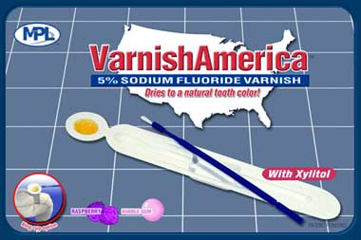
VarnishAmerica™
  5% Sodium Fluoride
  Contains xylitol (quantity unknown)
  0.25mL and 0.40mL sizes
  Remove excess saliva with a gauze sponge
  Bubble Gum Raspberry Flavor
  No Calcium Technology
© 3M 2008. All Rights Reserved.

Slide 56
Varnish America™ Directions for use
Using gentle finger pressure, open the child’s mouth.
Remove excess saliva with a gauze sponge.
Use your fingers and sponges to isolate the dry teeth and keep them dry. You will usually be able to isolate a quadrant of teeth at a time, but may have to work with fewer teeth in some children. Infants are easiest because they have only anterior teeth.
Apply a thin layer of the varnish to all surfaces of the teeth. Avoid
applying varnish on large open cavities where there may be pulp
involvement. Once the varnish is applied, you need not worry about
moisture (saliva) contamination. The varnish sets quickly.

Slide 57
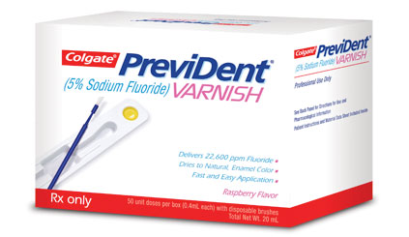
Colgate PreviDent® Varnish
  5% Sodium Fluoride
  .40mL unit doses
  Manufactured by Colgate Professional
  Wash and dry tooth surface prior to application
  Raspberry or Mint Flavor
  No Calcium Technology
© 3M 2008. All Rights Reserved.

Slide 58
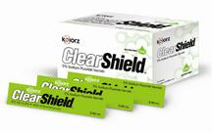
ClearShield 5% Sodium Fluoride Varnish
5% Sodium Fluoride
0.40 mL unit dose package
Manufactured by Kolorz
Drying the teeth is recommended before applying
Sweeten with Xylitol
Bubble-gum and Watermelon Flavors
No Calcium Technology

Slide 59
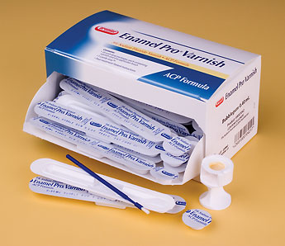
Enamel Pro® Varnish
  5% Sodium Fluoride
  Contains Amorphous Calcium Phosphate
  0.25mL and 0.40mL sizes
  Dry teeth first before applying
  Sweeten with Xylitol
  Bubble Gum or Strawberry n’ Cream Flavors
© 3M 2008. All Rights Reserved.

Slide 60
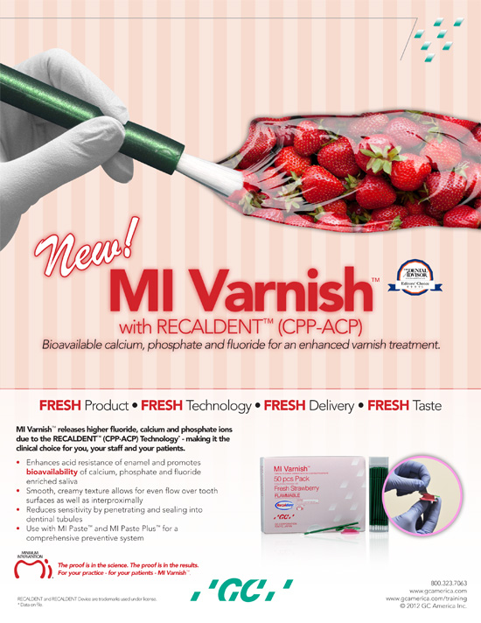
Tooth Surface should be clean and dried before application
Do not use on patients with a milk protein allergy
Mi Paste should remain on the teeth undisturbed for four hours
Flavors: Strawberry Cream

Slide 61
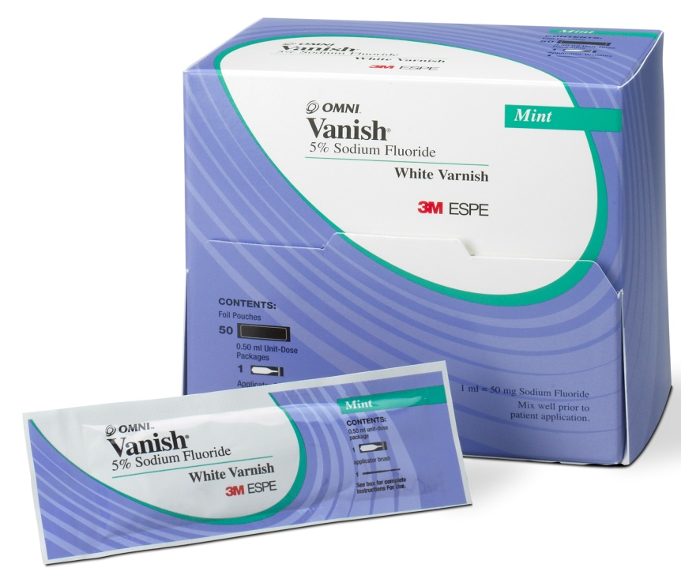
Vanish™
5% Sodium Fluoride White Varnish
with Tri-Calcium Phosphate
  1st varnish to be invisible on teeth
  Calcium & Phosphate technologies
  Teeth must be wet but not saturated with saliva
  Tenacious on teeth—stays put!
  Contains Xylitol
  Seconds to apply
  Mint, Cherry, and Melon Flavor
© 3M 2008. All Rights Reserved.

Slide 62


Slide 63
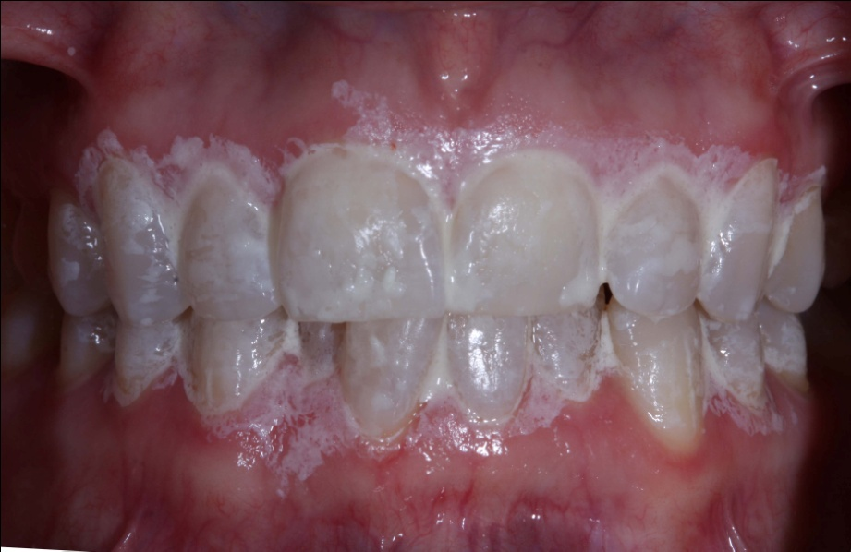
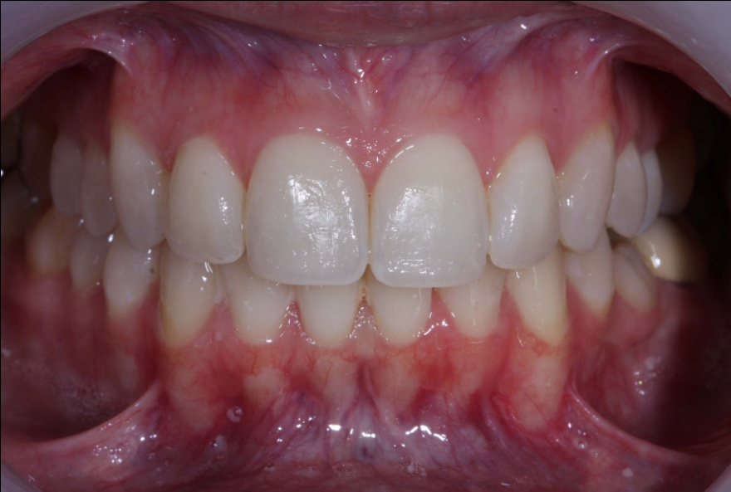

Slide 64
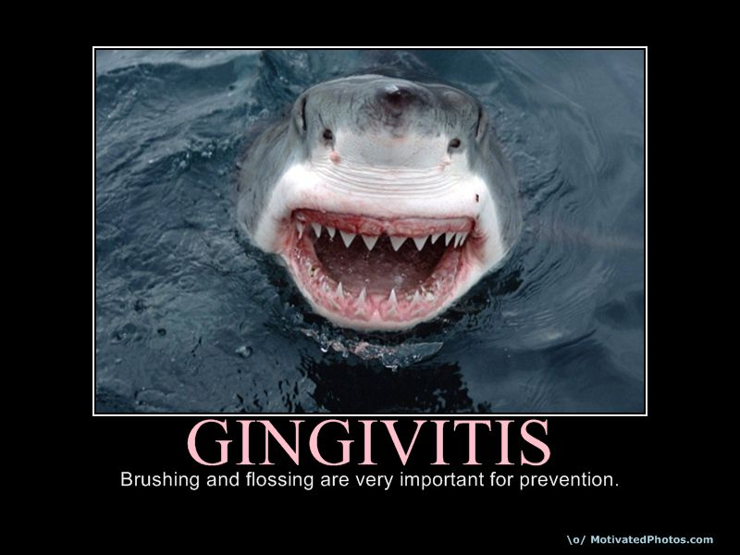
Bleeding Gums or Gingivitis

Slide 65
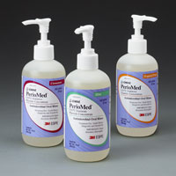
Stannous Fluoride: Large ion, greater substantivity- 8 to 10 hours
A fluoride salt of tin used in toothpaste and mouth rinses to reduce dental caries incidence and as an anti-plaque agent.
Label Indications:
Inflammation – Perio Patients
Hypersensitivity – Root exposure, Abfractions
Caries Control – Moderate to High Risk

Slide 66
0.12% Chlorhexidine
Chlorhexidine is recognized as the gold standard anti microbial in oral hygiene.
Antiseptic
Kills viruses, plaque, funguses, and microbes
Rinse with 15mL for 30 seconds twice a day
Significant reductions in plaque, gingivitis and bleeding sites.

Slide 67
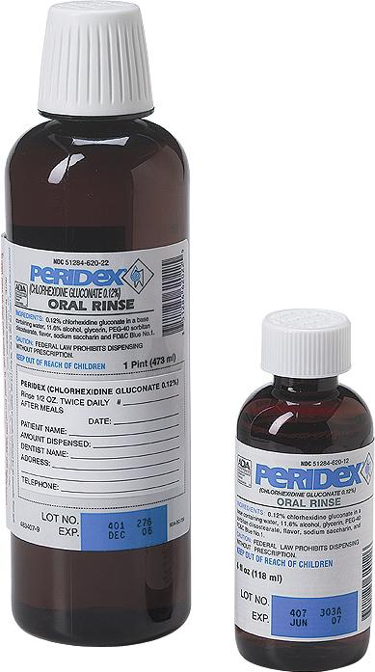
0.12% Chlorhexidine Rinses
Kill bacteria and virus for up to 12 hours
FDA Label indicated for gingival bleeding
17 Generic brands
Eliminates pathogenic bacterial infection
© 3M 2008. All Rights Reserved.

Slide 68
Medication Protocol for Soft Tissue Management
Gingivitis
  Gingivitis Therapy Treatment
    Rinse with Stannous Fluoride
    Re-evaluate in 3 months
Periodontal Disease
-SRP
      Rinse with CHX for up to 2 weeks only
      Maintain with Stannous Fluoride
      Re-evaluate in 6 weeks to 3 months

Slide 69
“Laboratories want better impressions”
Gordon J. Christensen, DDS, MSD, PhD
JADA, Vol 138, April 2007, p. 527-29.
“Patients planning to receive multiple crowns or fixed prostheses should use 0.12% chlorhexidine mouth rinse twice per day for one week before teeth are prepared….Soft tissues will be pink and firm…and bleeding will be minimal or nonexistent.”

Slide 70
SENSITIVITY
How do you treat it?

Slide 71
Today’s Oral Health: Protecting Roots from Caries and Sensitivity
Exposed Roots are High Risk!!!!!!!!!!!!!
57% of the general population have dentinal hypersensitivity.
98% of Periodontal patients have dentinal hypersensitivity.
Abrasive over-the-counter and prescription toothpastes are contributing to the rise in sensitivity in adult patients
Dentin has about a quarter of the hardness of enamel
Fact: Slicker, Harder teeth have Less stain, plaque, & debris and guess what! No Sensitivity!

Slide 72
Potassium Nitrate 5%
Potassium nitrate desensitizes the nerve.
Potassium ions penetrate through the dentinal tubules to depolarize the nerves and prevent repolarization from occurring.
This blocks pain signals to the brain. It works like an analgesic by numbing the nerve and masking the pain as opposed to fixing the problem.
All OTC sensitivity pastes contain 5% potassium nitrate.

Slide 73
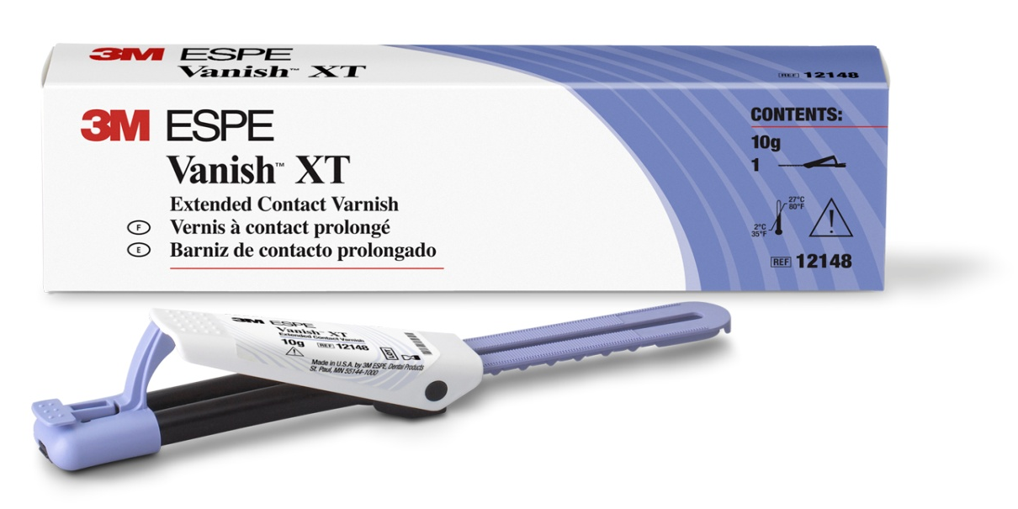
Vanish XT
Site-specific, durable protective coating for enamel and dentin tooth surfaces
Light-cured resin modified glass ionomer - two-part liquid/paste system.
  All the major benefits of glass ionomer materials
  Sustained fluoride, calcium and phosphate release.
Clicker™ Dispensing System
Prolonged working time
20 second light cure
S

Slide 74
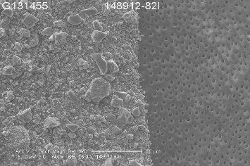
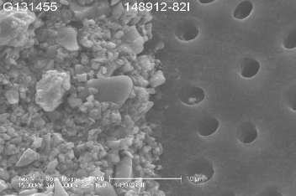
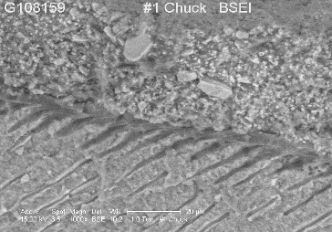
Immediate Occlusion of Dentin Tubules
Vanish™ XT Extended Contact Varnish immediately after application to dentin. Exposed dentin tubules can be seen on the right; coated and sealed dentin tubules can be seen on the left.
(1000X magnification)
(3000X magnification)
Cross-sectional view of Vanish™ XT Extended Contact Varnish applied over exposed dentin tubules
Vanish™ XT Coating
Resin tags penetrating the tubules
Hybrid layer
Dentin
(1000X magnification)

Slide 75
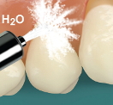
Application Technique – Sensitivity
1. Clean the tooth surface
4. Dispense Vanish™ XT onto mixing pad
6. Apply thin layer of Vanish XT to tooth surface
2. Rinse with water
5. Mix components together rapidly for 15 seconds
(2.5 min. working time)
7. Light cure for 20 seconds
3. Dry with
cotton
applicator
8. Wipe the coating with a moist cotton applicator
Notes:
Missing drying step.

Slide 76
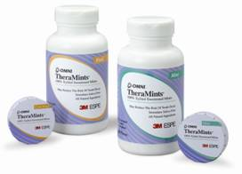
Xylitol
May reduce the risk of tooth decay
  Certain bacteria (i.e. strep mutans) can’t digest xylitol
    They can’t create the destructive acids that demineralize enamel
Helps promote saliva flow to neutralize pH of mouth
Readily available
  Gums
  Candies (mints)
Requires long-term therapy
Patient compliance is needed
Acts as laxative in high quantity
Caries Risk patients must use 100% Xylitol
  Moderate Risk 2 grams 3 times a day
  High Risk – 2 grams 5 times a day
Notes:
Xylitol is a very interesting ingredient in many dental preparations. It’s a sweetener that can be used in place of other sweeteners such as sorbitol or sugars. Certain bacteria (including strep mutans) are not able to digest xylitol and create acids that dissolve the teeth. It also has a reduced calorie count and can be a great sweetener for diabetic patients. It’s glycemic index is 7 rather than 100 like glucose.

Slide 77
Restoration Protection
One treatment in two parts
Home care review
In office varnish with TCP for sensitivity and caries protection (off label).
Home care 5000 ppm with TCP for caries protection and sensitivity (off label)
Treat the symptom and the cause.
Notes:
This protocol can be introduced by the assistant following the restoration. Here is where the dental assistant will contribute to the prevention protocol
77

Slide 78
Re-Care Appointment
Child Prophy $85.00
Caries susceptibility test $ .00
Intra-Oral Camera $ .00
Irrigation with Chlorhexidine $ .00
Nutritional Counseling $ .00
Oral Hygiene Instructions $ .00
Application of desensitizing medicament $ .00
Oral Cancer Screening $ .00
Comprehensive periodontal evaluation $ .00
Complimentary “Toothbrush, Floss, D0999 $ .00
Blood Pressure $ .00
Total Due $85.00

Slide 79
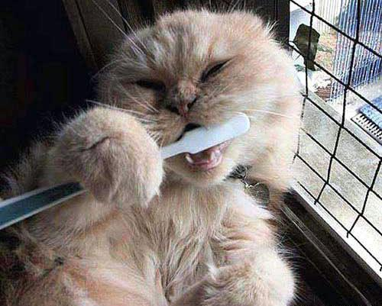
QUESTIONS

Slide 80


Slide 81
THANK YOU!
© 3M 2008. All Rights Reserved.

